Slide 1
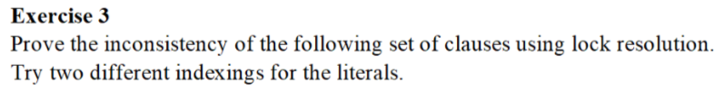
Problem statement

Slide 2
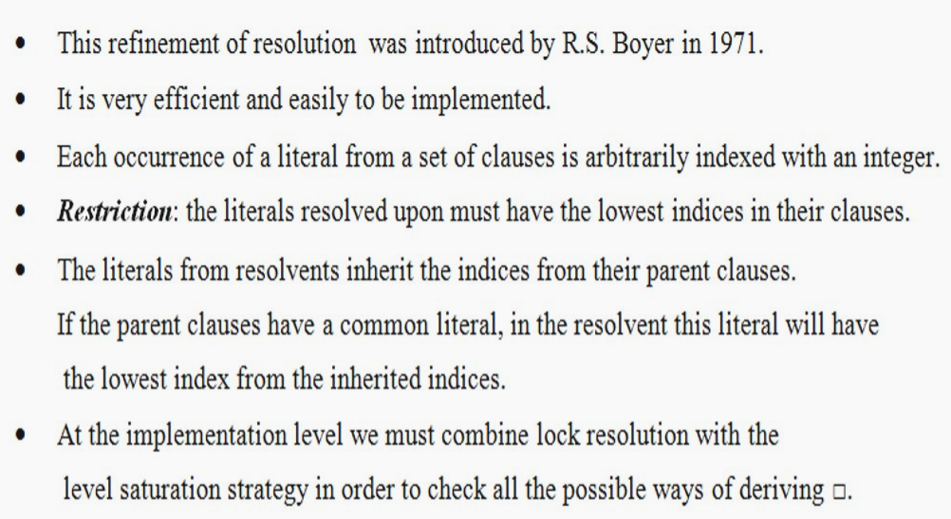

Slide 3
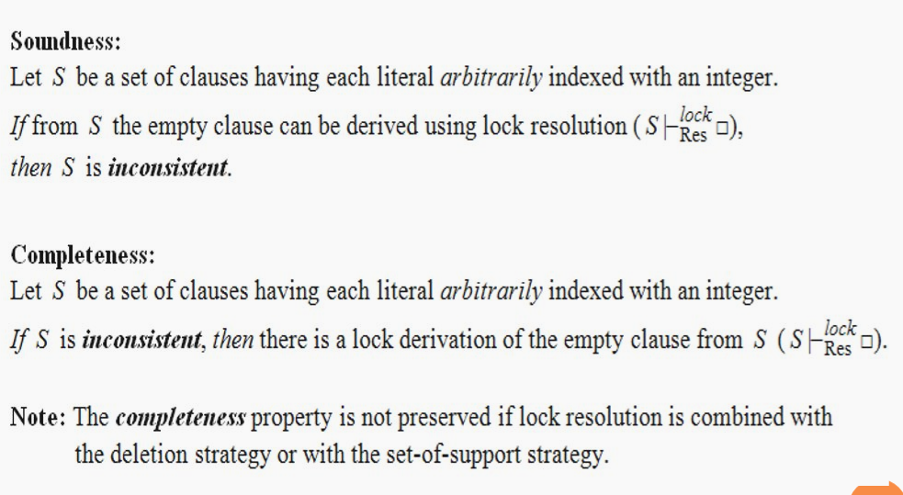

Slide 4
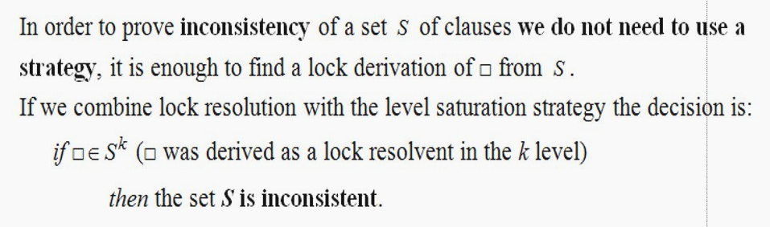

Slide 5
Indexing of the literals:
C1:₍₂₎P(x) ∨ ₍₁₎¬Q(x) C2= ₍₅₎¬P(a) ∨ ₍₄₎R(x) C3=₍₃₎Q(x)
C4= ₍₈₎W(z) C5= ₍₆₎¬R(y) ∨ ₍₇₎ ¬W(y)
C6= Res^{Pr}(C1,C3)=₍₂₎P(x)
C7= Res_{Θ1=[y<-x]}^{Pr}(C5,C2)= ₍₅₎¬P(a) ∨ ₍₇₎ ¬W(x) (y changed to x in C5)
C8=Res _{Θ2=[z<-x]}^{Pr}(C4,C7)= ₍₅₎¬P(a) (z changed to x in C4)
C9=Res _{Θ3=[a<-x]}^{Pr}(C8,C6)= □ (a changed to x in C8)
S₂|-_{Res}^{lock,Pr} □ and thus S₂ is inconsistent

Slide 6
Another indexing of the literals:
C1:₍₆₎P(x) ∨ ₍₅₎¬Q(x) C2= ₍₃₎¬P(a) ∨ ₍₄₎R(x) C3=₍₇₎Q(x)
C4= ₍₈₎W(z) C5= ₍₁₎¬R(y) ∨ ₍₂₎ ¬W(y)
C6= Res^{Pr}(C1,C3)=₍₆₎P(x)
C7= Res_{Θ1=[a<-x]}^{Pr}(C2,C6)= ₍₄₎R(x) (a changed to x in C2)
C8= Res_{Θ2=[y<-x]}^{Pr}(C5,C7)= ₍₂₎ ¬W(x) (y changed to x in C5)
C9= Res_{Θ3=[z<-x]} ^{Pr}(C4,C8)= □ (z changed to x in C4)
S₂|-_{Res}^{lock,Pr} □ and thus S₂ is inconsistent

Slide 7
Conclusions
By checking the inconsistency of the set S₂ of clauses using lock resolution we conclude:
S₂|-_{Res}^{lock,Pr} □ and thus S₂ is inconsistent

